Slide 1
Disruptive Innovation
Definitions:
Christensen - “disruptive innovation refers to a technological or market advance that fundamentally transforms or creates entirely new markets”. As shown by the definition, a disruptive innovation can either completely alter the economics and the means of exchange of an existing market (for example, Amazon for the Book market), or result in the creation of an entirely new market for products/services (for example, the Internet). Blockchain, has the capability to operate both as a “market distruptor” and a “new market creator”.
The four principles:
Incumbents improvement along a trajectory of innovation
The pace of sustaining innovation overshoots the customer needs
Incumbents have the capability to respond but fail to exploit it
Incumbents flounder as a result of the disruption
The big idea
….

Slide 2
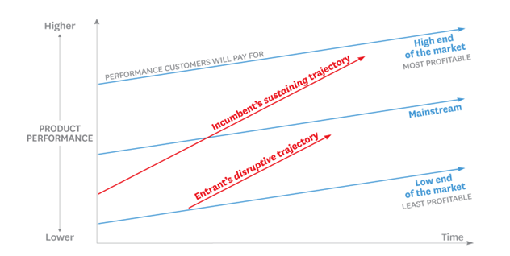
graph of disruptive innovation
Low end disruption model, source: https://hbr.org/2015/12/what-is-disruptive-innovation
Notes:
Uber
Incumbent
1

Slide 3
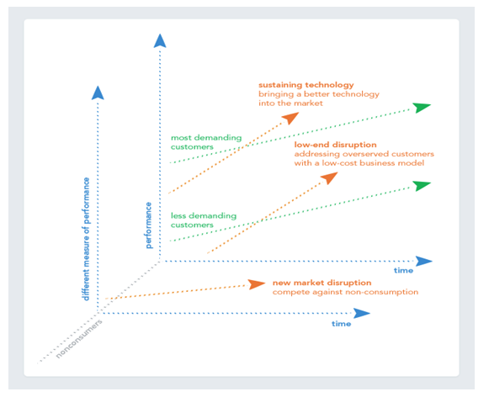
Low end and new market disruption model, source: https://blog.intercom.com/what-everyone-needs-to-know-about-disruption/

Slide 4
Advantages & Disadvantages

Slide 5
How Low Cost Carriers (LLC) disrupted flight market
Incumbents like BA and KLM
- Sustain growth: free food & drinks, lounge, prime time departure, main airports, airmiles, generous baggage allowance. Improving performance!
Disrupters Easy Jet, Ryan Air
- Inferior product: no free food, drinks, lounges or allocated seats, limited luggage allowance, no ‘frills’ Just a safe flight
Notes:
1

Slide 6
4 Principles
Incumbents Overshoot
KLM and BA adding more choices on food and seating arrangements for a high price
LLC looked for new market at the ‘fringe’
A new market of people that would otherwise not fly. New users talk about this new product and get attention from existing users
Incumbents could have reacted
KLM and BA could have bootstrapped their product but would loose reputation and existing customers
Incumbents fail
KLM and BA are loosing market-share but will the LLC crush the incumbents?
Notes:
1

Slide 7
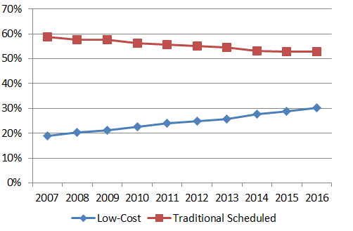
Impacts and options
LCC inspite of recession grew from 20% to 30% of total traffic 2007-2016
LCC flying from main airports to enlarge their market
BA and KLM started to charge for service
STATFOR figures flight traffic
Eurocontrol 2017
www.eurocontrol.int/news

Slide 8
Incumbents could have reacted
KLM and BA could have bootstrapped their product but would loose reputation and existing customers
Notes:
1

Slide 9
Incumbents could have reacted
KLM and BA could have bootstrapped their product but would loose reputation and existing customers
Notes:
1

Slide 10
Incumbents could have reacted
KLM and BA could have bootstrapped their product but would loose reputation and existing customers
Notes:
<number>

Slide 11
What can you say against it
Notes:
Kwame – Impacts to long haul flights.
<number>

Slide 13
Example 2
Apple increase

Slide 14
How they made use of disruptive innovation

Slide 15
What can you say against it
Notes:
<number>

Slide 16
Example 3 – Against
Tata Group (Vistra Airlines)
Notes:
Start up disruptive enough?
<number>

Slide 17
How they made use of disruptive innovation

Slide 18
What can you say against it

Slide 19
Questions
Does disruptive technologies exist or does it not based upon Tata’s example?

Slide 20
Questions
Thank you!

Slide 21
Notes:

Slide 22
References:
http://pedrotrillo.com/wp-content/uploads/2016/01/Whatisdisruptiveinnovation.pdf

Slide 23
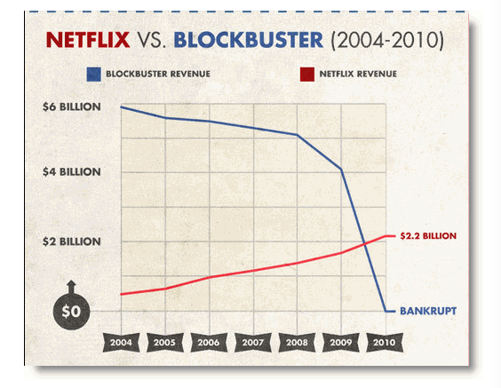
source: http://go-digital.net/blog/2011/02/netflix-vs-blockbuster-perfect-example-of-an-industry-replaced-by-a-more-efficient-version-of-itself/

